Slide 1
Enhanced Sampling Methods
A Brief Introduction

Slide 2
Learning Objectives
At the end of this lecture you should be able to:
Explain why we use enhanced sampling methods
Explain what a collective variable is
Qualitatively explain umbrella sampling is, how it works, and what it can yield
Qualitatively explain what metadynamics is, how it works, and what it can yield

Slide 3
Collective Variables
Something that can be calculated from the coordinates of the atoms in your system
Examples:
Bond distance
Radius of gyration
Potential energy
Good ones differentiate between stable states
Why bother?
Reduce dimensionality of system to a few degrees of freedom (i.e. x, y, z coords for 2 atoms vs distance)

Slide 4
MD -> Energy Landscape
Probability of a given state is connected with the free energy of the state
Not NVE
F(s) = -k_{B}T ln(P(s))
See McQuarrie or Frenkel & Smit for Stat Mech Rev.
Standard MD
Run simulation, keep track of how often states are visited (i.e. CV values typically in grid form)
Setup normalized histogram to get P based on counts

Slide 5
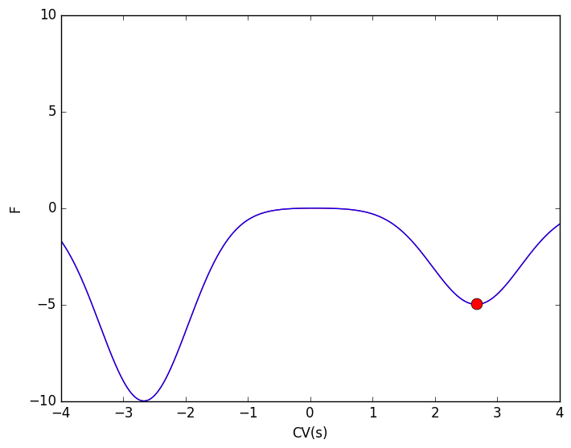
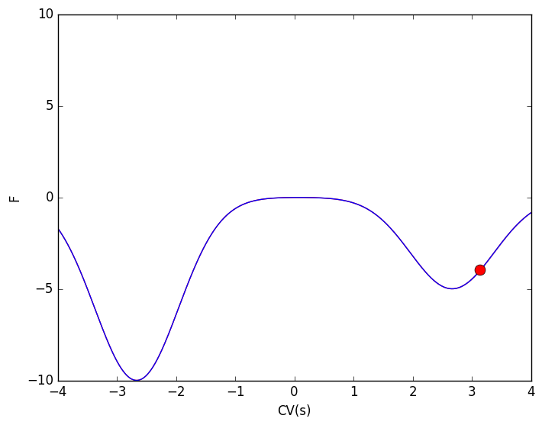
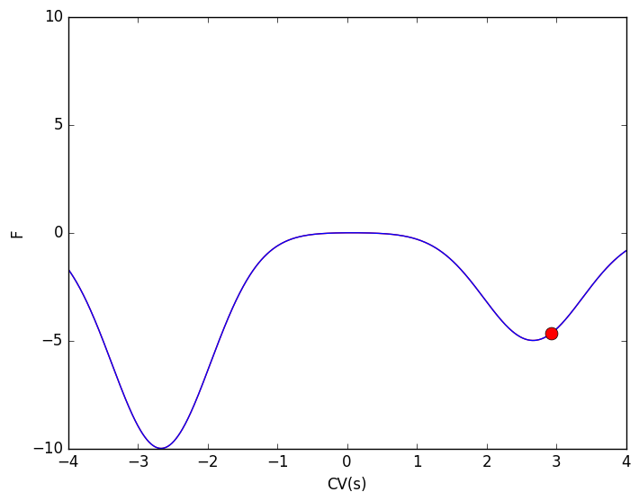
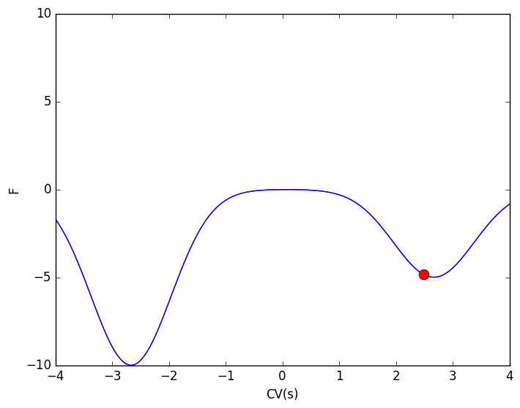

Why Bother w/ ES?
MD is expensive:
Time scale of integration << Time scale of transitions
Waste time exploring un-interesting phase space
Dynamic information requires multiple events
Enhanced sampling methods reduce computation time spent characterizing systems!

Slide 6
Umbrella Sampling
Note: for this
Analytical case
F and U are
interchangeable.
Lit. will use U in
Equations.
P_{target}(s) = exp(-F(s)/k_{B}T)

Slide 7
Umbrella Sampling
P_{target} = exp(-F/k_{B}T)
P_{target} (s) = exp(-F(s)/k_{B}T)
Lets add a static bias (V_{bias})
to force our system to
high energy states.
Harmonic restraint in this case

Slide 8
Umbrella Sampling
Sum the bias potential and
the underlying target potential together
and we can sample higher, less
regions with a probability distribution of
P_{target+bias} = exp(-β(F+V_{Bias}))
These are all functions of s.

Slide 9
Umbrella Sampling
Sum the bias potential and
the underlying target potential together
and we can sample higher, less
regions with a probability distribution of
P_{target+bias} = exp(-β(F+V_{Bias}))
Perform a series simulations with
windows placed at different CV values.
Must ensure overlap of distributions
between adjacent windows.

Slide 10
Umbrella Sampling
So what? How does this help?f
After a series of simulations, we get something like this. Windows are run for equal time, so counts correlate directly to probability.
Each window is defined by:
P_{target+bias} = exp(-β(F+V_{Bias}))
CV (s)
http://www.bevanlab.biochem.vt.edu/Pages/Personal/justin/gmx-tutorials/umbrella/Images/histo.jpg

Slide 11
Umbrella Sampling Reweighting
We have sampled the full system and have P_{target+bias} = exp(-(F+V_{Bias})/k_{B}T) for all CV values.
But remember V_{Bias} is a static bias that we introduced for each frame
Therefore we know the value of V_{bias} at each CV value!
Lets say w(s) = exp(V_{bias}(s)/k_{B}T)
Reweighting
P_{target+bias} = exp(-(F+V_{Bias})/k_{B}T)
P_{target+bias} (s) * w(s) = exp(-(F)/k_{B}T) =P_{target}
F(s) = -k_{B}T ln(P(s))
WHAM is the common method to perform this

Slide 12

Umbrella Recap
Introduce static bias in a series of simulations to force our system out of low energy wells
Use knowledge of the bias we applied to recover the true underlying probability distribution → Free energy

Slide 13
Switching Gears
Questions
Break?

Slide 14
Metadynamics
Broad family of enhanced sampling methods
Many different flavors
No longer static bias, evolves over time
Key concept: Deposit a history dependent bias potential in the form of Gaussians, along a few key CVs to discourage the system from re-visiting previously explored phase space.

Slide 15
Metadynamics
Construct the bias on the fly
Every n # steps we drop a small amount of bias at our current CV location
Bias is in the form of energy as a function of CVs
By raising the energy (via the bias), we decrease the probability of sampling it again
Encouraging our system to sample other areas without bias
Bias builds throughout simulation

Slide 16
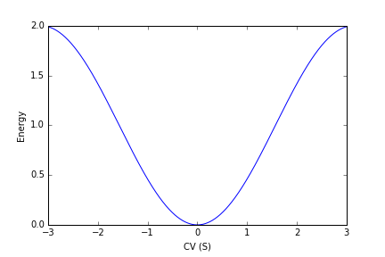
Walkthrough
Underlying potential

Slide 17
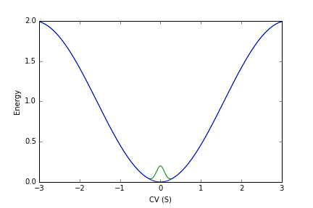
Walkthrough
Lets say we are at S=0 when we want to deposit a hill.

Slide 18
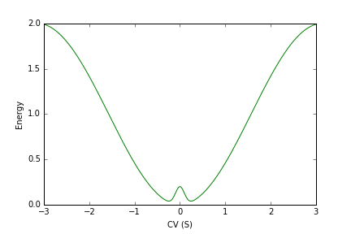
Walkthrough
We have now changed the underlying energy landscape!
What our system now feels:
V = V_{pot} + V_{bias}
F = -dV/dS
Gaussian centered at CV=0

Slide 19
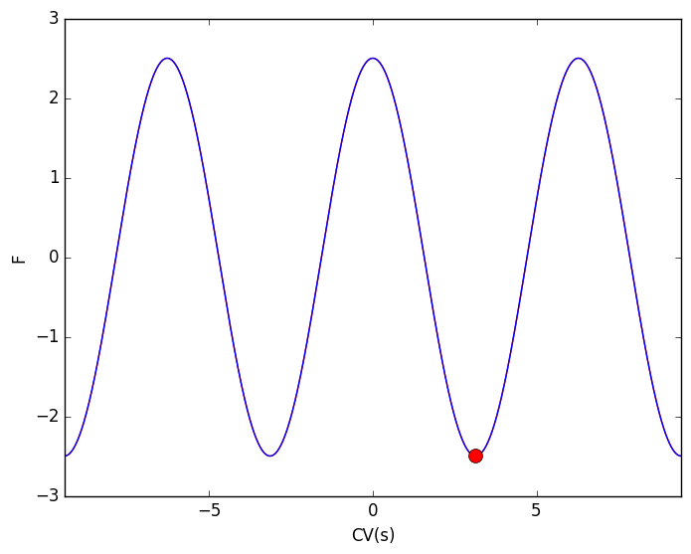
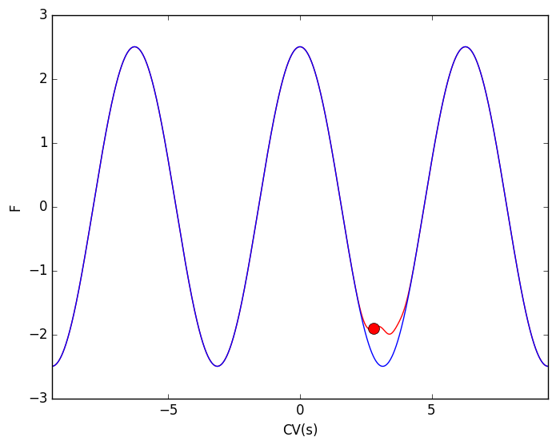
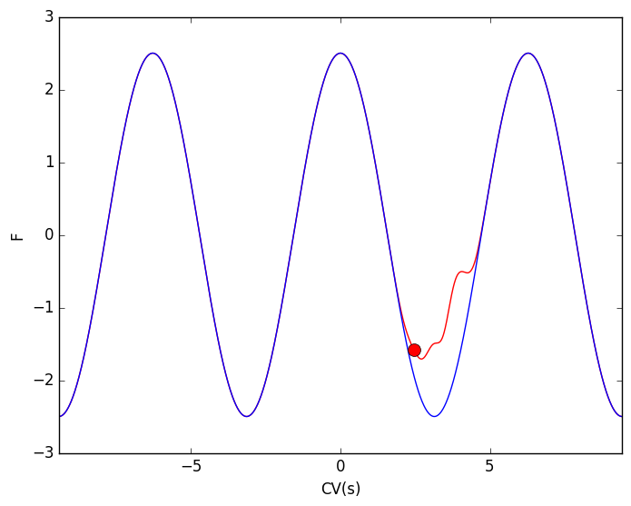
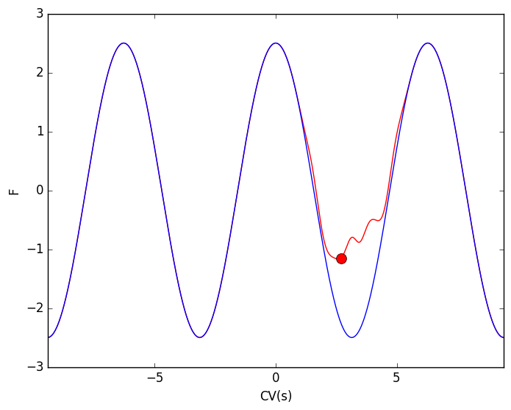
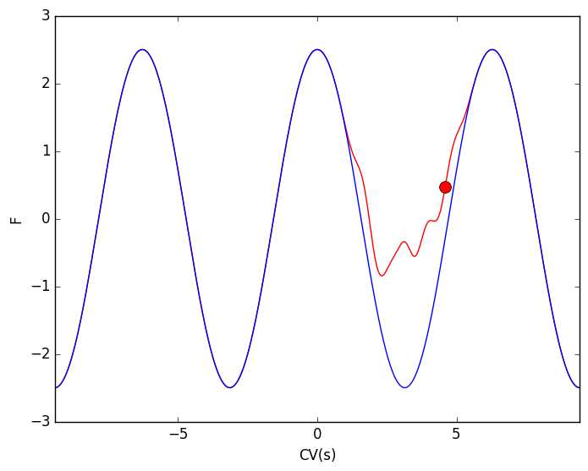
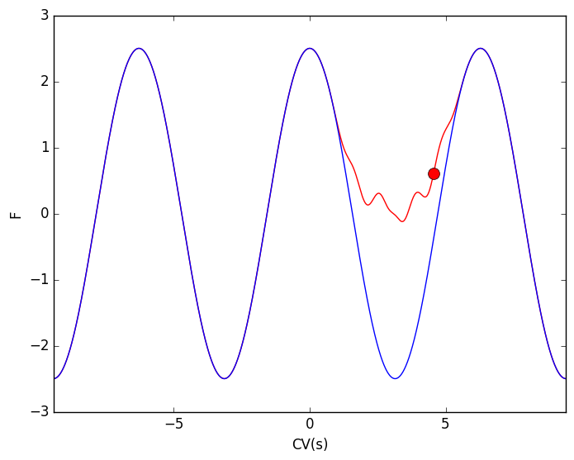
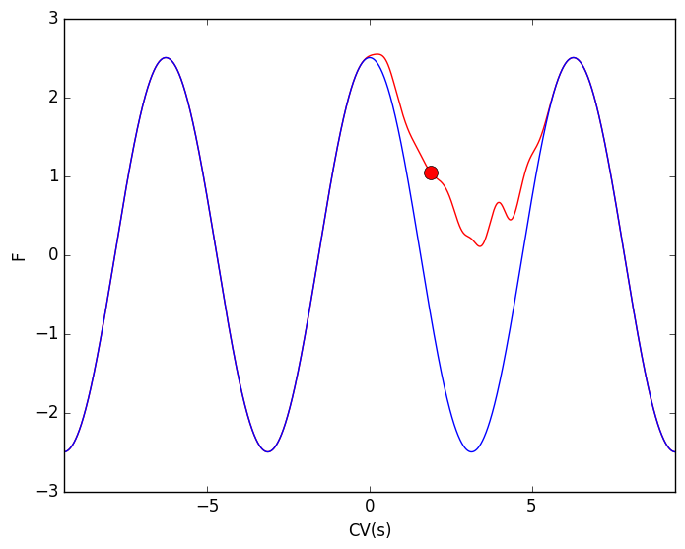
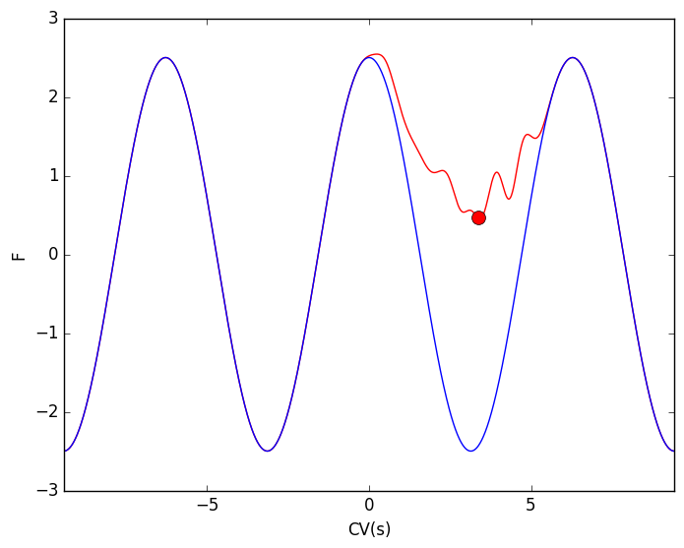
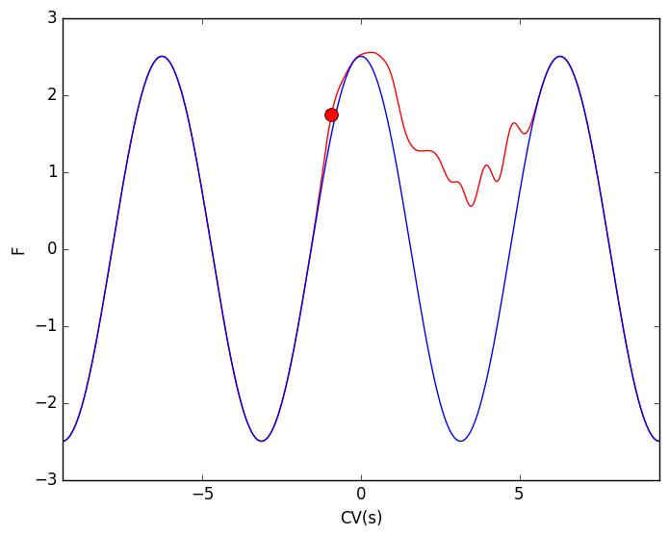
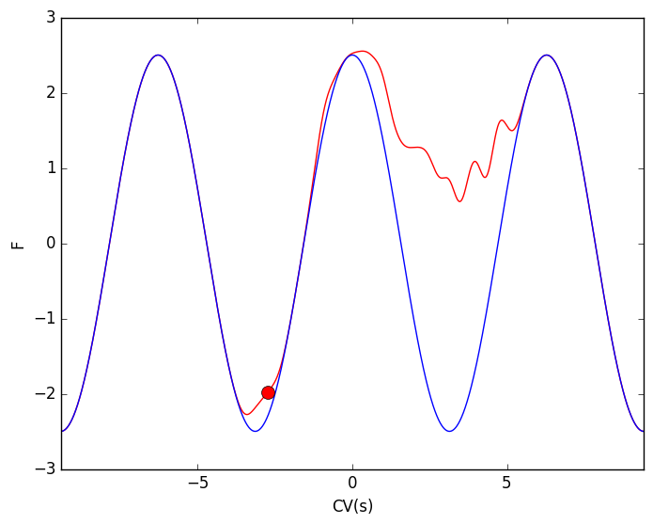
Graphic Courtesy of LimPy³ http://zenodo.org/record/62068

Slide 20
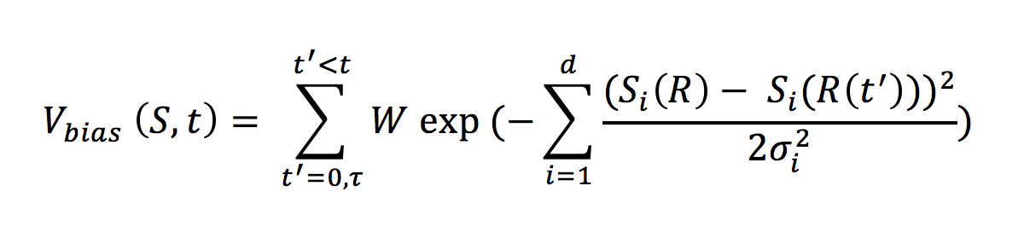
The Bias (V_{bias})
Function of time and CV (S).
i refers to the CV (if multi-dimensional)
t’ refers only to times of depositions
*R the actual coordinates

Slide 21
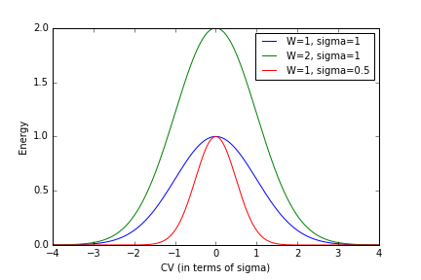
The Bias (V_{bias})
Gaussians are deposited every τ, centered at S(R(t)).
Gaussians height → W
Gaussian width → σ
Vbias is the sum of all deposited Gaussians with respect to location (S) at time (t)
https://upload.wikimedia.org/wikipedia/commons/thumb/7/74/Normal_Distribution_PDF.svg/360px-Normal_Distribution_PDF.svg.png

Slide 22
Constructing the bias
Lets deposit a hill every 10 steps
Height (W) of 0.25
Sigma of 0.1

Slide 23
Initial System
Only 1 CV

Slide 24
10 steps in…
0 Hills deposited so far
Current S value = -0.5
Time = 10 steps
Deposit Hill at S=-0.5
V_{bias}(-0.5,10) =
=0.25*exp(-(-0.5 - -0.5)²/(2*0.1²))= 0.25

Slide 25
10 steps in…
1 Hills deposited so far
Current S value = -0.5
Time = 10 steps
Deposit Hill at S=-0.5
V_{bias}(-0.5,10) =
=0.25*exp(-(-0.5 - -0.5)²/(2*0.1²))= 0.25

Slide 26
20 steps in…
1 Hills deposited so far
Current S value = 0.25
Time = 20 steps
Deposit Hill at S = 0.25
V_{bias}(0.25,20) =
=0.25*exp(-(0.25 + 0.5)²/(2*0.1²) )+
0.25*exp(-(0.25 - 0.25)²/(2*0.1²) )= 0.25

Slide 27
20 steps in…
2 Hills deposited so far
Current S value = 0.25
Time = 20 steps
Deposit Hill at S = 0.25
V_{bias}(0.25,20) =
=0.25*exp(-(-0.25 – 0.5)²/(2*0.1²)) +
0.25*exp(-(0.25 - 0.25)²/(2*0.1²)) = 0.25

Slide 28
30 steps in…
2 Hills deposited so far
Current S value = 0.1
Time = 30 steps
Deposit Hill at S = 0.1
V_{bias}(0.1,30) =
=0.25*exp(-(0.1 + 0.5)²/(2*0.1²)) +
0.25*exp(-(0.1 – 0.25)²/(2*0.1²)) +
0.25*exp(-(0.1- 0.1)²/(2*0.1²)) = 0.36

Slide 29
30 steps in…
2 Hills deposited so far
Current S value = 0.1
Time = 30 steps
Deposit Hill at S = 0.1
V_{bias}(0.1,30) =
=0.25*exp(-(0.1 + 0.5)²/(2*0.1²)) +
0.25*exp(-(0.1 – 0.25)²/(2*0.1²)) +
0.25*exp-((0.1- 0.1)²/(2*0.1²)) = 0.36

Slide 30
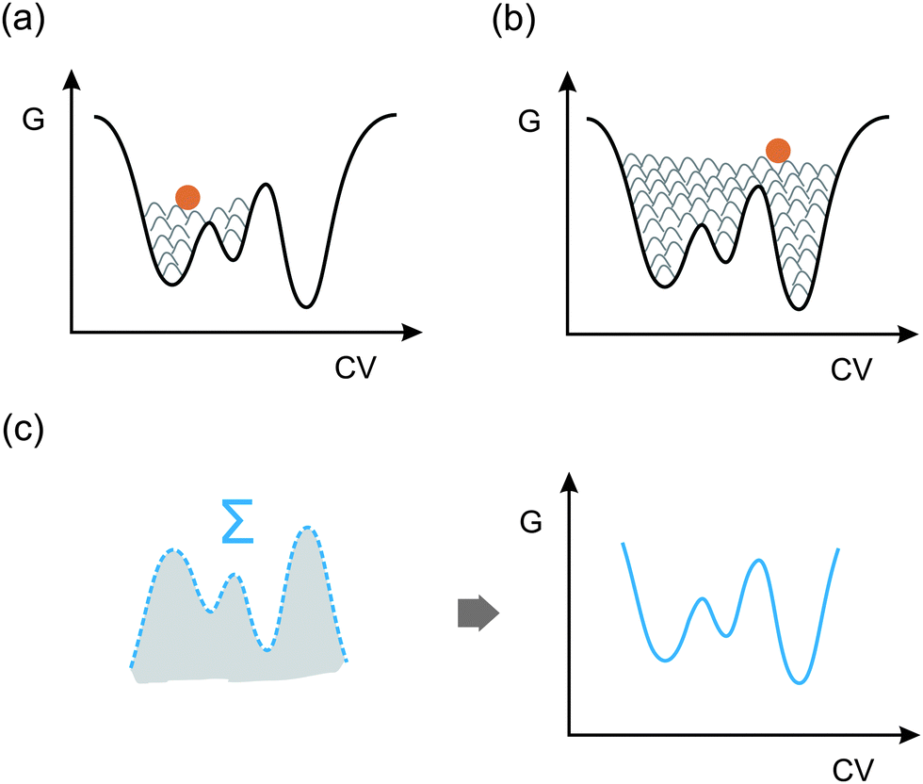
Recovering a FES
Flattened Landscape
P_{target+bias} = exp(-β(F+V_{Bias}))
Same Everywhere!
V_{bias}(S,t→∞) = -F(S) + C
http://pubs.rsc.org/services/images/RSCpubs.ePlatform.Service.FreeContent.ImageService.svc/ImageService/Articleimage/2014/CS/c4cs00146j/c4cs00146j-f11_hi-res.gif

Slide 31
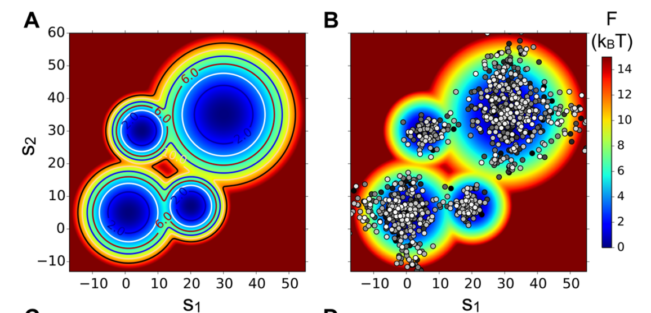
Converged Simulations
Bias is deposited everywhere, system is in “diffusive state”
Points shift from black to white with time

Slide 32
Converged Simulations
Little to no change in FES with time.
Check FES at different points in simulation and monitor change.

Slide 33
Parameter Rules
Typically requires refinement but simple rules of thumb:
σ approximated by ½ of the CV standard deviation from MD run
W generally ~1/20 of barrier to overcome
Deposition Stride – depends – needs to be slow enough that system sufficiently relaxes between hills
Proper parameters help expedite convergence!!!
Also necessary for kinetics (but I don’t want to talk about this)

Slide 34
Discussion/Brainstorm
MetaD vs Umbrella Sampling
Advantages/Disadvantages?
When to use either?
Potential pitfalls of using enhanced sampling methods?

Slide 35

PLUMED
Plug-in for free energy calculations compatible with MD packages:
GROMACS
CP2K
AMBER
Others
Set up to run MetaD & other methods
http://www.plumed.org

Slide 36
PLUMED WALKTHROUGH
PLUMED
Implements variants of MetaD
Useful for tracking/calculating CVs
Very useful for post-trajectory analysis
To run:
Gromacs:
add –plumed plumed.dat flag to mdrun command
Amber:
add plumed=1, plumedfile=‘plumed.dat’ to input file
CP2K:
add block to input file to link to plumed file

Slide 37
Homework
Use driver module in plumed to calculate phi dihedral angle for a finished simulation
Use plumed built in CV
Also calculate using MATHEVAL
Calculate using Gromacs
Calculate using VMD
See tar file on github for detailed instructions and files.

Slide 38
Homework (cont.)
Read one of the papers and answer the following questions:
How does this differ to standard MetaD?
What are its advantages/disadvantages compared to standard MetaD?
Is this implemented in PLUMED?
Papers:
(1) Barducci, A.; Bussi, G.; Parrinello, M. Well-Tempered Metadynamics: A Smoothly Converging and Tunable Free-Energy Method. Phys. Rev. Lett. 2008, 100 (2), 1–4.
(2) Tiwary, P.; Parrinello, M. From Metadynamics to Dynamics. Phys. Rev. Lett. 2013, 111 (23), 230602.
(3) Pfaendtner, J.; Bonomi, M. Efficient Sampling of High-Dimensional Free-Energy Landscapes with Parallel Bias Metadynamics. J. Chem. Theory Comput. 2015, 11 (11), 5062–5067.

Slide 39
Sources
(1) Valsson, O.; Tiwary, P.; Parrinello, M. Enhancing Important Fluctuations: Rare Events and Metadynamics from a Conceptual Viewpoint. Annu. Rev. Phys. Chem. 2016, 67, 159–184.
(2) Barducci, A.; Bonomi, M.; Parrinello, M. Metadynamics. Wiley Interdiscip. Rev. Comput. Mol. Sci. 2011, 1 (5), 826–843.
(3) Zheng, S.; Pfaendtner, J. Enhanced Sampling of Chemical and Biochemical Reactions with Metadynamics. Mol. Simul. 2014, 41 (1–3), 55–72.
http://www.plumed.org
http://dx.doi.org/10.1016/0021-9991(77)90121-8
McQuarrie
Frenkel & Smit

